Slide 1


Smart School Bus Safety and Monitoring Ecosystem
25-26J-282

Slide 2


Context
School transportation in urban environments where safety and visibility are manual and fragmented.
Stakeholders
Parents
School Children's
School Authorities,
Bus Drivers,
Emergency Services

Slide 3
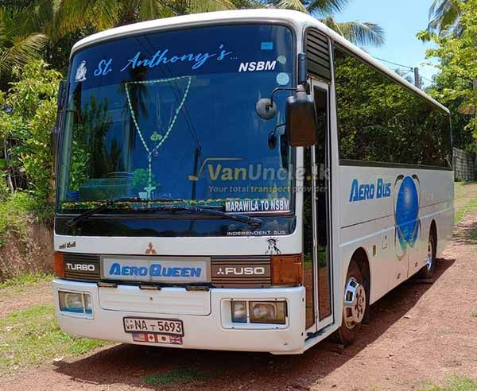
Introduction to the Problem
SISURAKSHA
Lack of Digital Attendance & Visibility
Dangerous behaviors such as students leaning out of windows and traveling on the footboard often go undetected due to the lack of continuous monitoring.
Drivers utilize static routing systems that fail to adapt to daily changes.
There is no unified mechanism for handling emergency situations

Slide 4
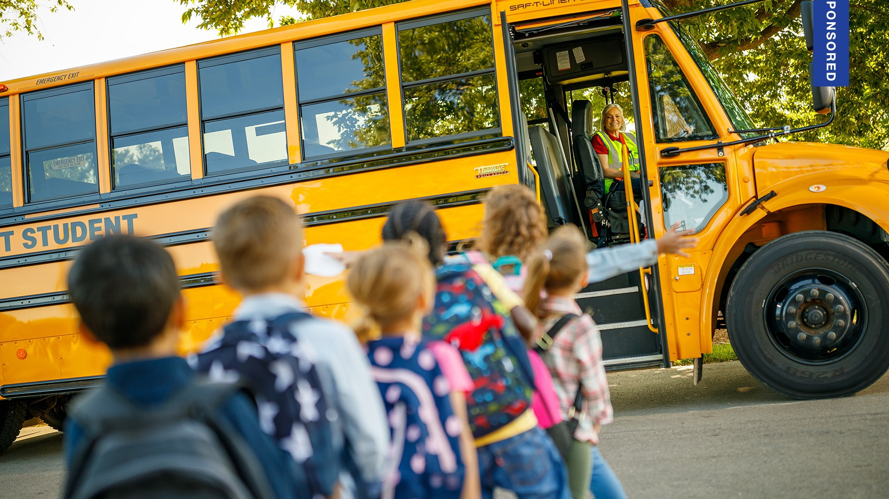

Research Gap
Current market solutions are isolated; they might offer GPS or CCTV, but they do not integrate them.
Main Objective
To develop a unified IoT and AI ecosystem that ensures student safety through real time monitoring and 100% data integrity using Blockchain.
There is no existing end-to-end trust driven platform that combines attendance verification, safety monitoring, and emergency response in one system.

Slide 5
Solution Overview
A unified ecosystem integrating NFC / Face ID validation, behavioral recognition, and Blockchain-backed auditing for total transparency.
Key features delivered
Automated Attendance: Dual layered verification using RFID and Fail-safe Facial Recognition.
Proactive Safety: ML-based detection for footboard travel, window safety, and driver fatigue.
Intelligent Routing: Segmented Polyline Analysis for driver student matchmaking and dynamic route optimization.
Blockchain Audit: Tamper-proof storage for all student attendance logs using ETHERIUM .

Slide 6
System Integrity & Performance
Data Immutability: Ethereum-based hybrid architecture for tamper-proof attendance logs.
High Availability: Face Recognition fail-safe to ensure 100% accuracy if RFID cards are missing.
Real-Time Alerts: Immediate driver notification for dangerous behaviors (footboard/window safety).
Operational Precision: Segmented Polyline Analysis for accurate, road-aware student-driver matchmaking.
Resource Efficiency: Off-chain storage with on-chain anchoring to minimize blockchain gas costs.
System Scalability: Unified ecosystem integrating IoT, ML models, and mobile interfaces.

Slide 7
Commercialization & Market Impact
Target Market: Private school bus associations and urban educational institutions.
Unique Value: "Trust-as-a-Service" via blockchain-backed immutable safety audits.
Cost Efficiency: ML-based dynamic routing to reduce fuel and vehicle wear.
Affordability: Low-cost hardware (ESP32, RFID, IR) for small-scale operators.
Revenue Model: Subscription-based "Verified" safety alerts for parents.
Market Gap: Unified emergency response framework for crashes and hazards.

Slide 8

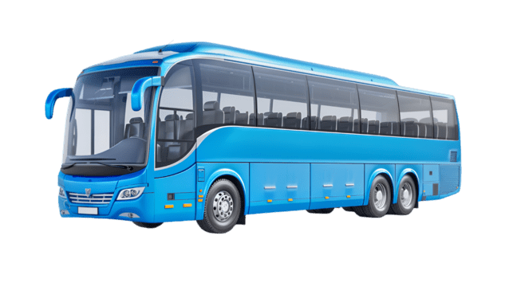
Blockchain Based RFID Attendance Management System and Segmented Polyline Analysis for Verifiable Driver-Student Matchmaking
IT22590312 | Akther M.H.S
Specialized in Information Technology
IT22590312 | Akther M.H.S | 25-26J-282

Slide 9
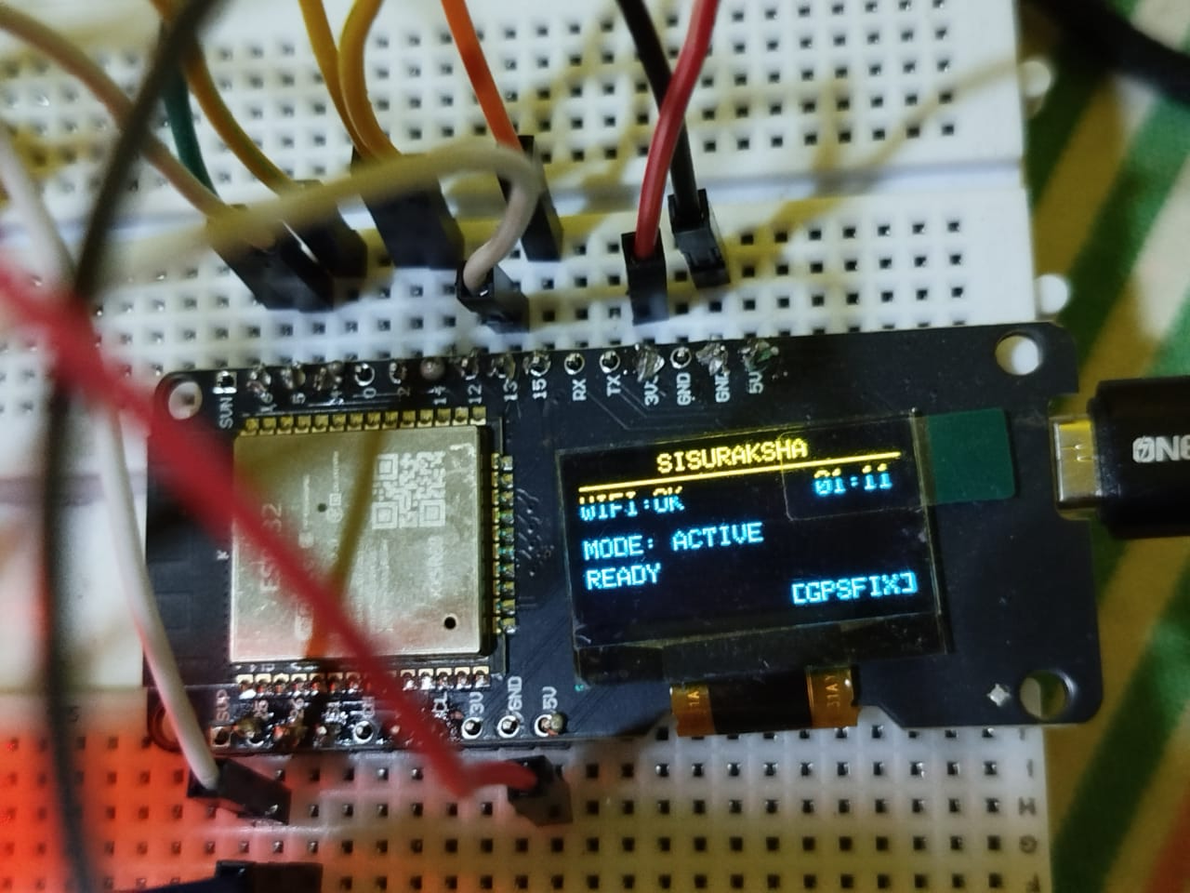
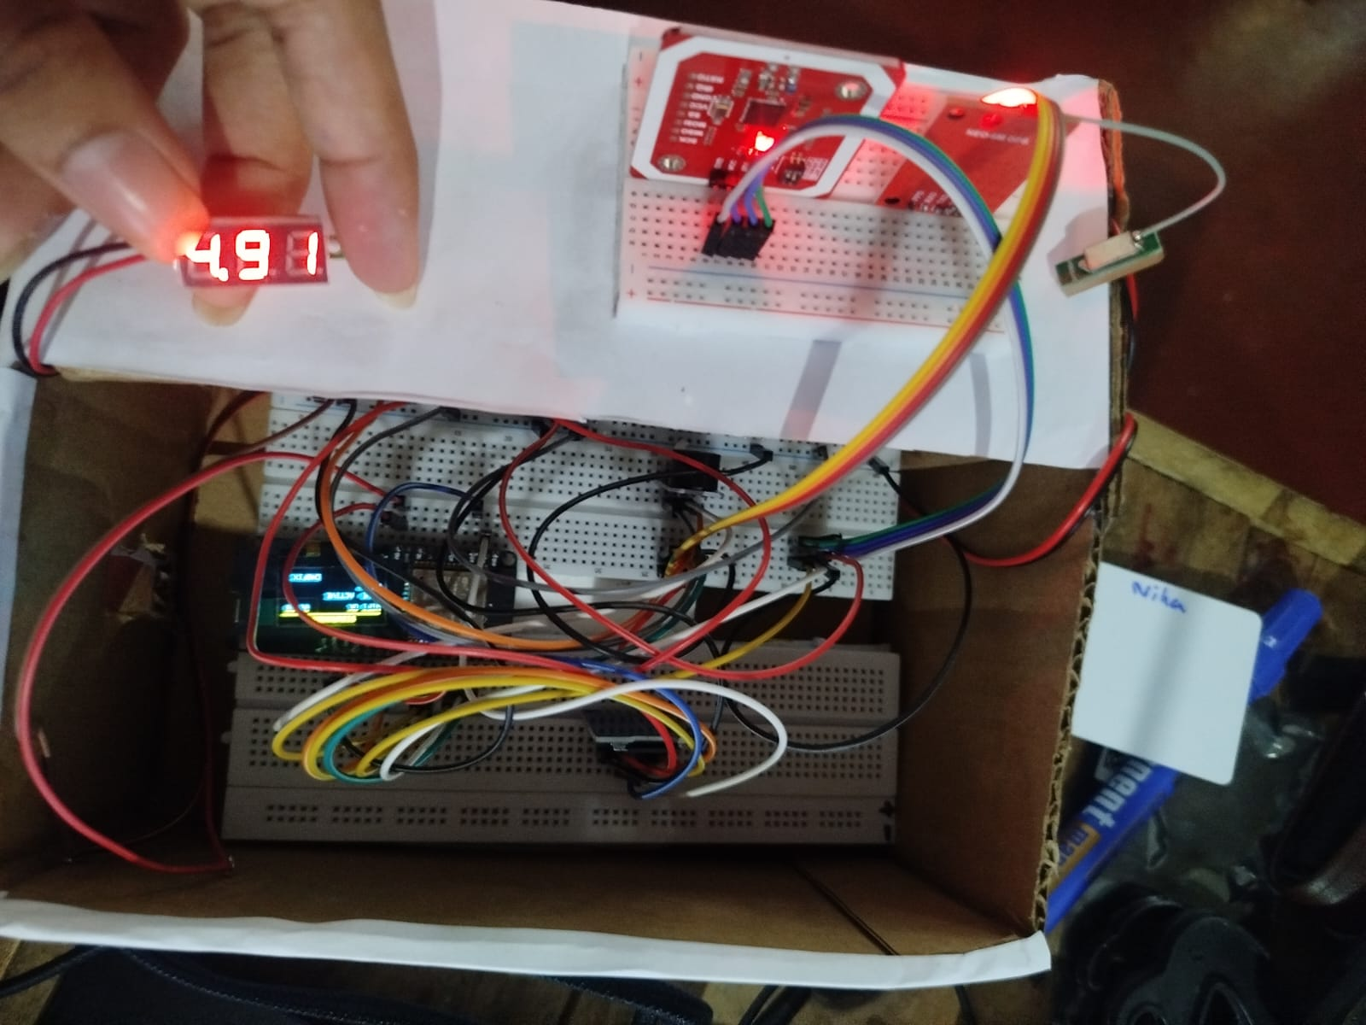
Blockchain Based RFID Attendance Management System
A secure IoT integrated framework that uses RFID for automated student tracking and Blockchain for tamper-proof data storage.
Core Purpose is To bridge the gap between physical student movements and digital records with 100% data integrity.

Slide 10
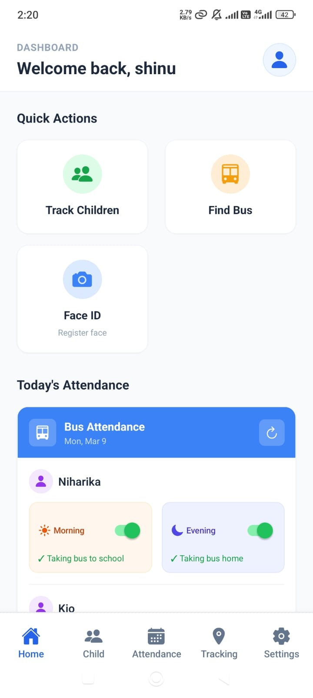
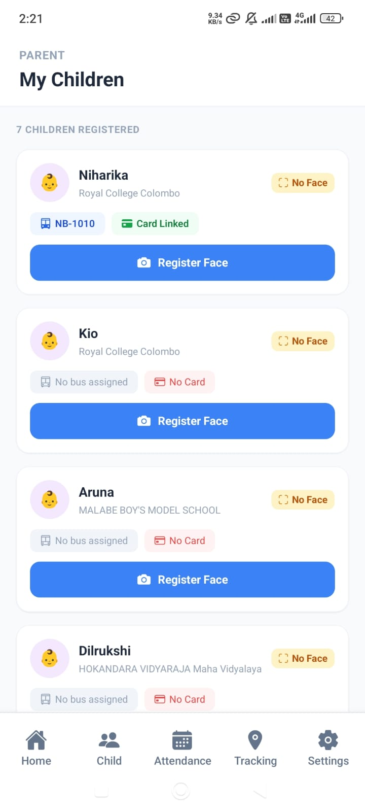
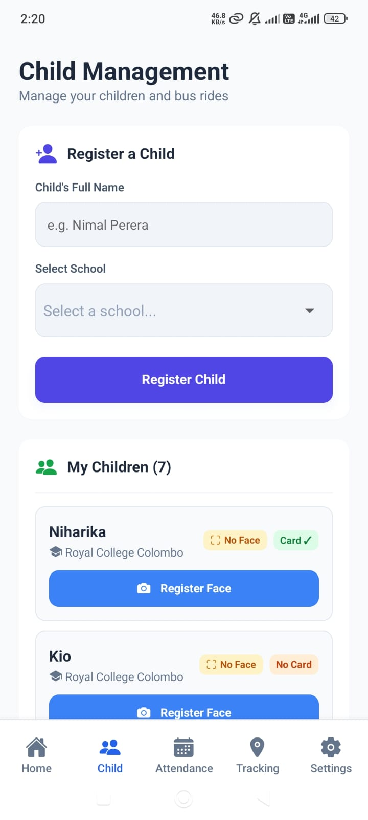
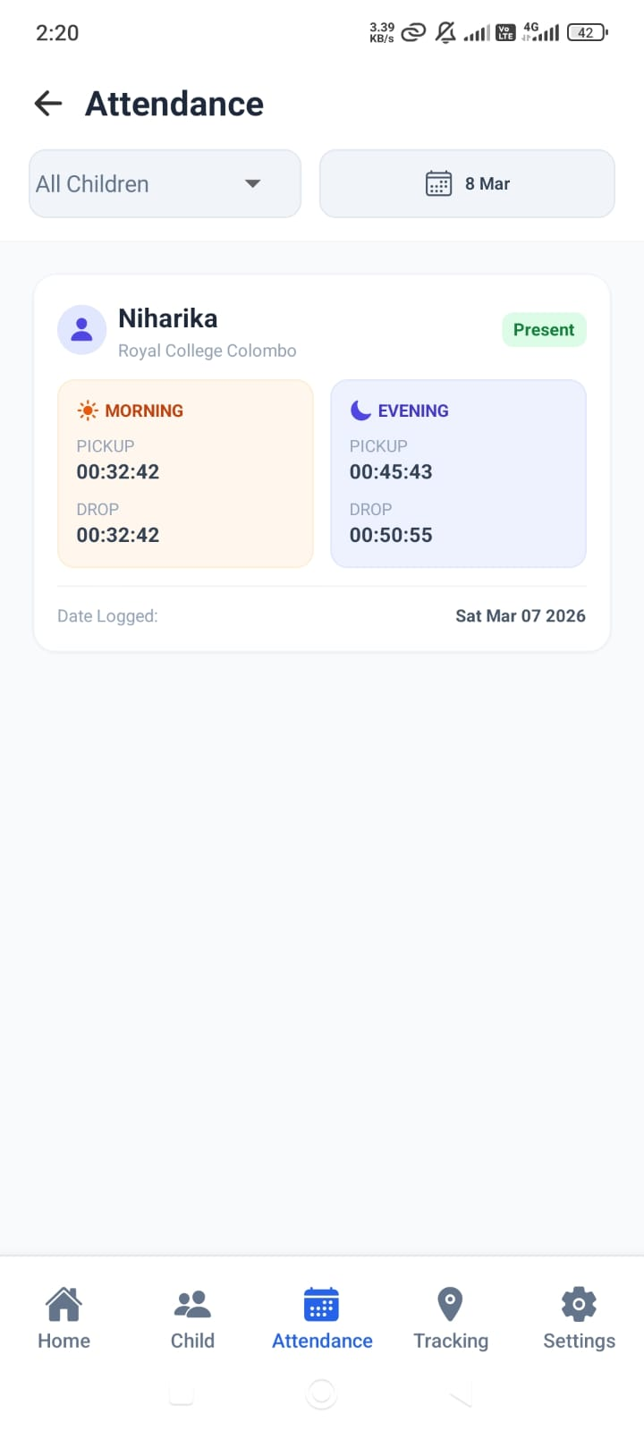
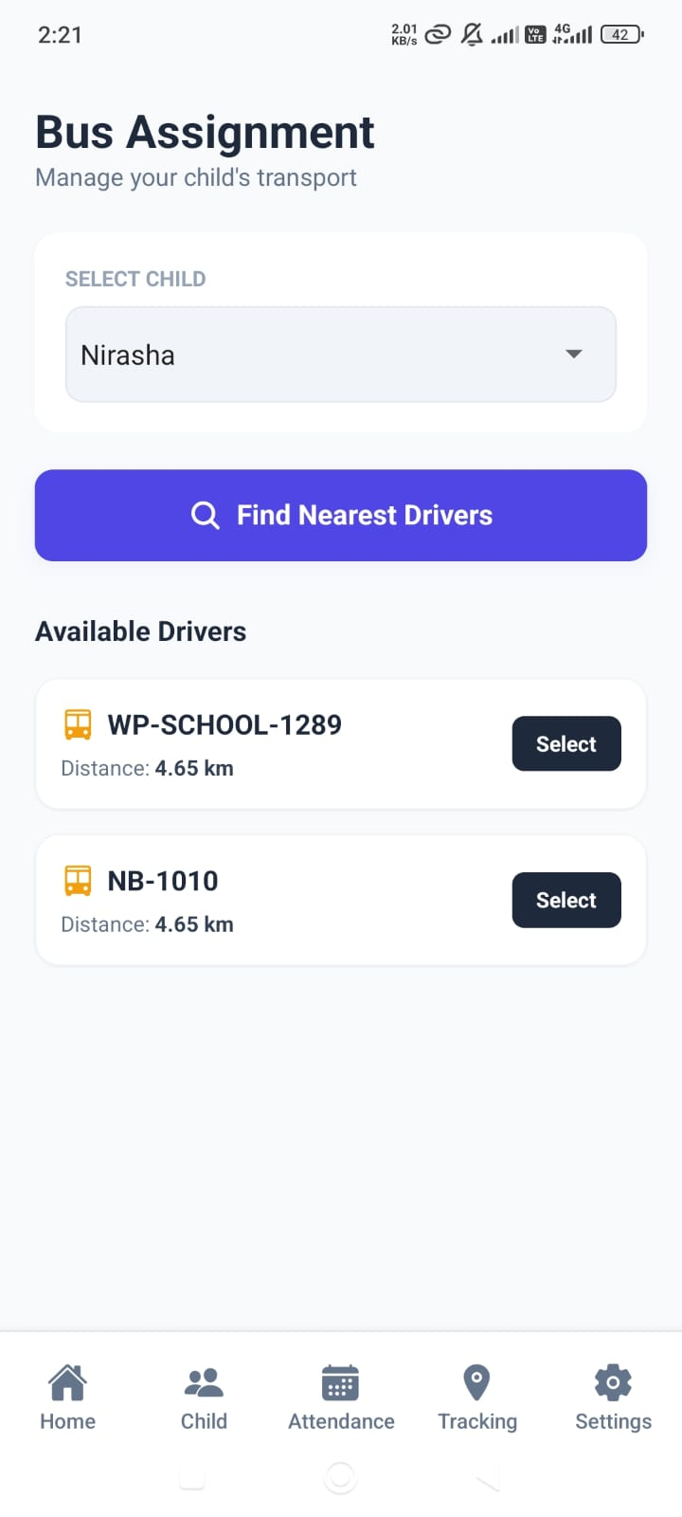
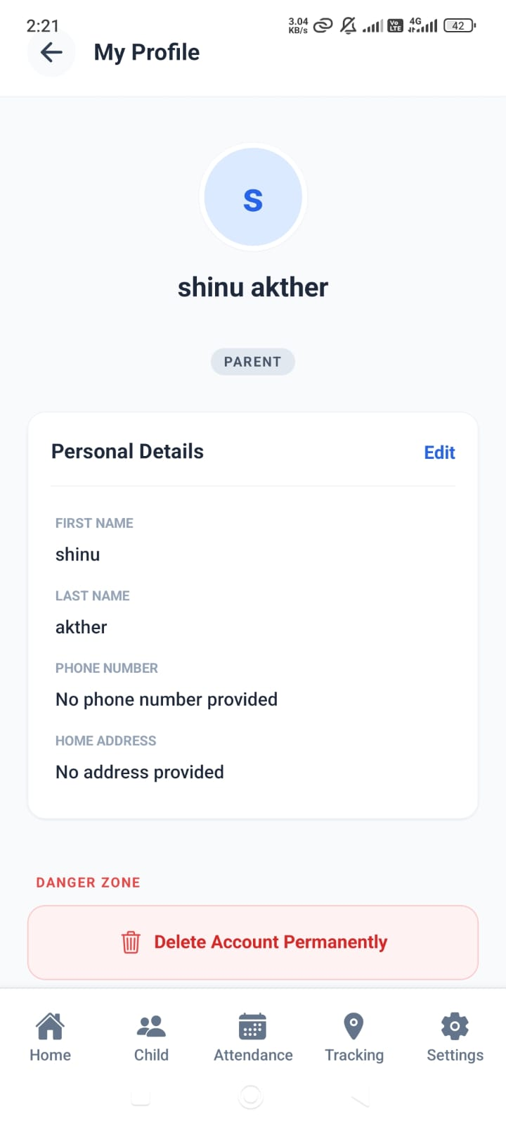
USER INTERFACES

Slide 11
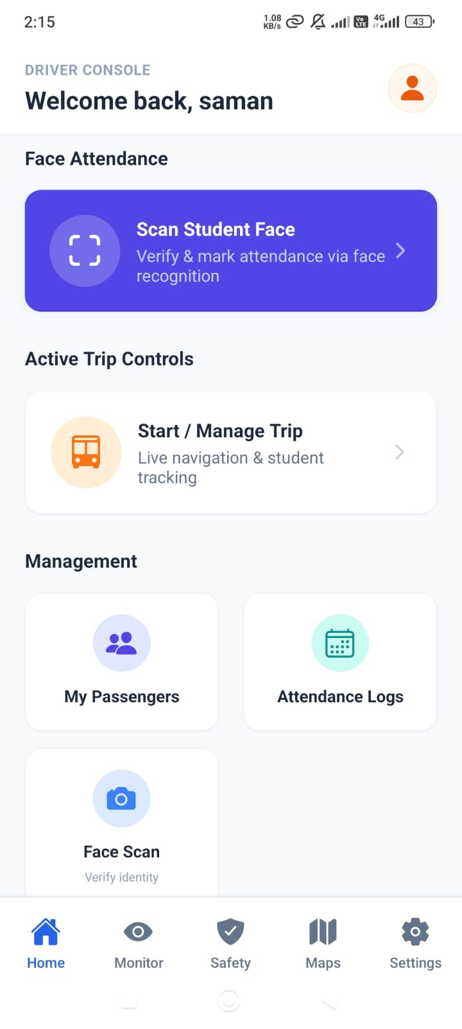
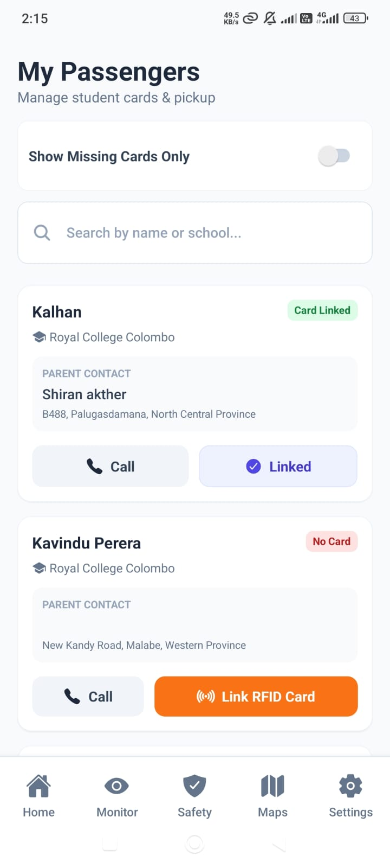
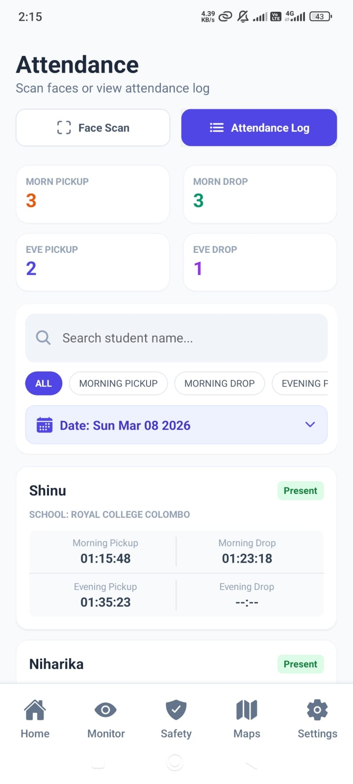
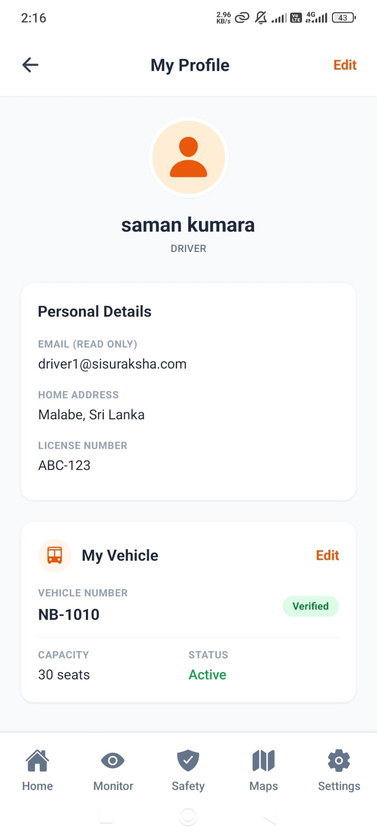
USER INTERFACES

Slide 12
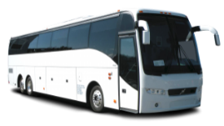

Segmented Polyline Analysis for Intelligent Driver-Student Matchmaking
Start
The Traditional Approach
Uses Euclidean distance (Straight lines) between two GPS points.
Problem is it Ignores physical urban geography (Buildings, Rivers, One-way streets).
Matches a bus physically close but operationally unreachable
User
End

Slide 13

Segmented Polyline Analysis for Intelligent Driver-Student Matchmaking
Start
The polyline approach
The system detects drivers who actually drive past the student's home, even if their trip started far away.
Instead of drawing a straight line on a map, it checks the exact road path to see if the bus comes close enough to the house.
User
End

Slide 14

IT22606624 | Shameera T.A.P.K Smart bus crash detections and safety window
Specialized in Information Technology
IT22606624 | Shameera T.A.P.K | 25-26J-282

Slide 15
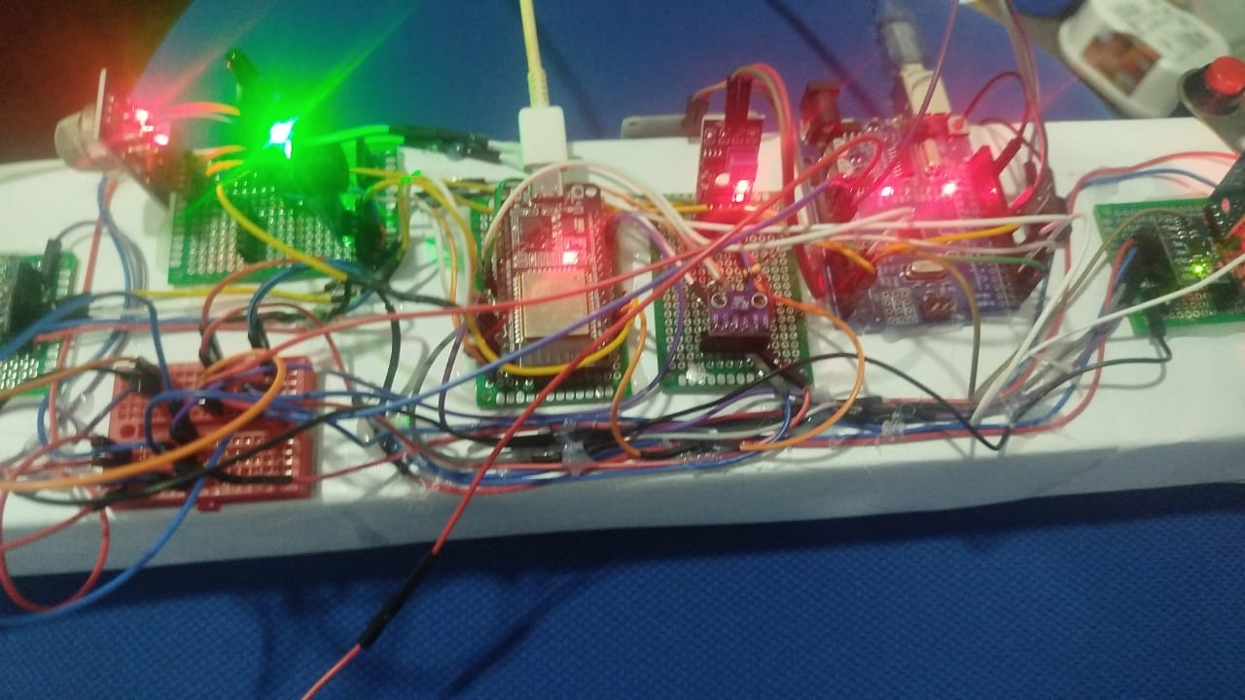
Smart bus crash detections and safety window
A smart safety monitoring system that uses multiple sensors to detect hazards such as vehicle crashes, fire, smoke, and water in real time and trigger alerts for improved safety
Core Purpose: To enhance safety by detecting accidents and environmental hazards in real time using sensors and automatically triggering alerts for quick emergency response.

Slide 16

Smart bus crash detections and safety window
To enhance student safety inside school buses by detecting unsafe window interactions in real time using sensors and immediately alerting the driver or supervisor for quick preventive action.
Core Purpose is To enhance student safety inside school buses by detecting unsafe window interactions in real time using sensors and immediately alerting the driver or supervisor for quick preventive action.

Slide 17
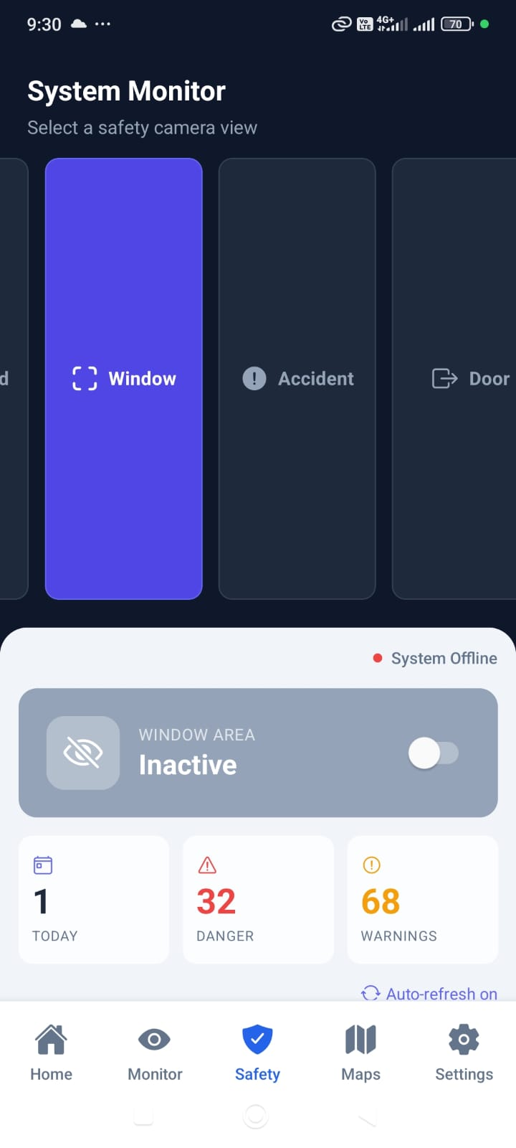
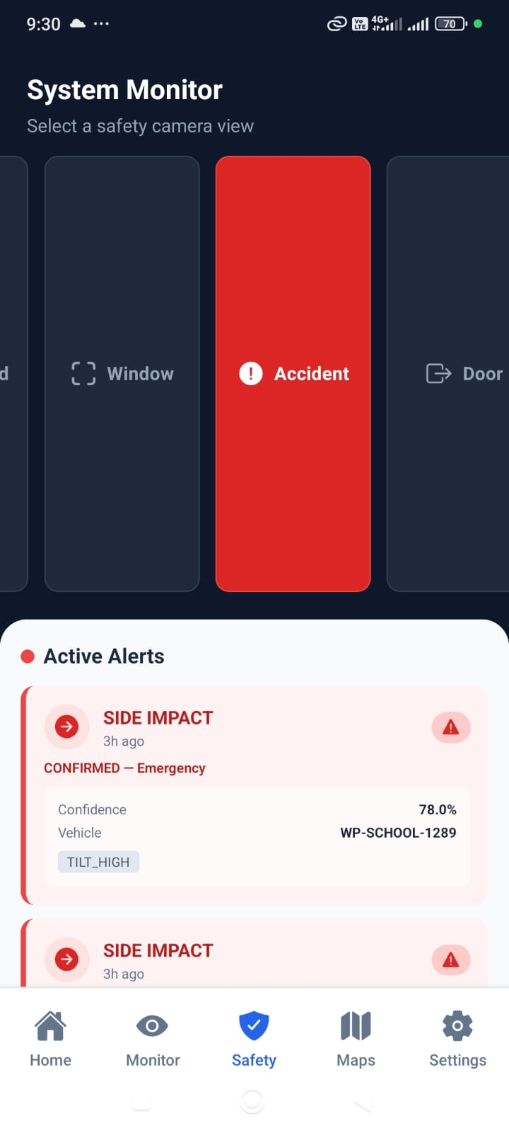
USER INTERFACES

Slide 18
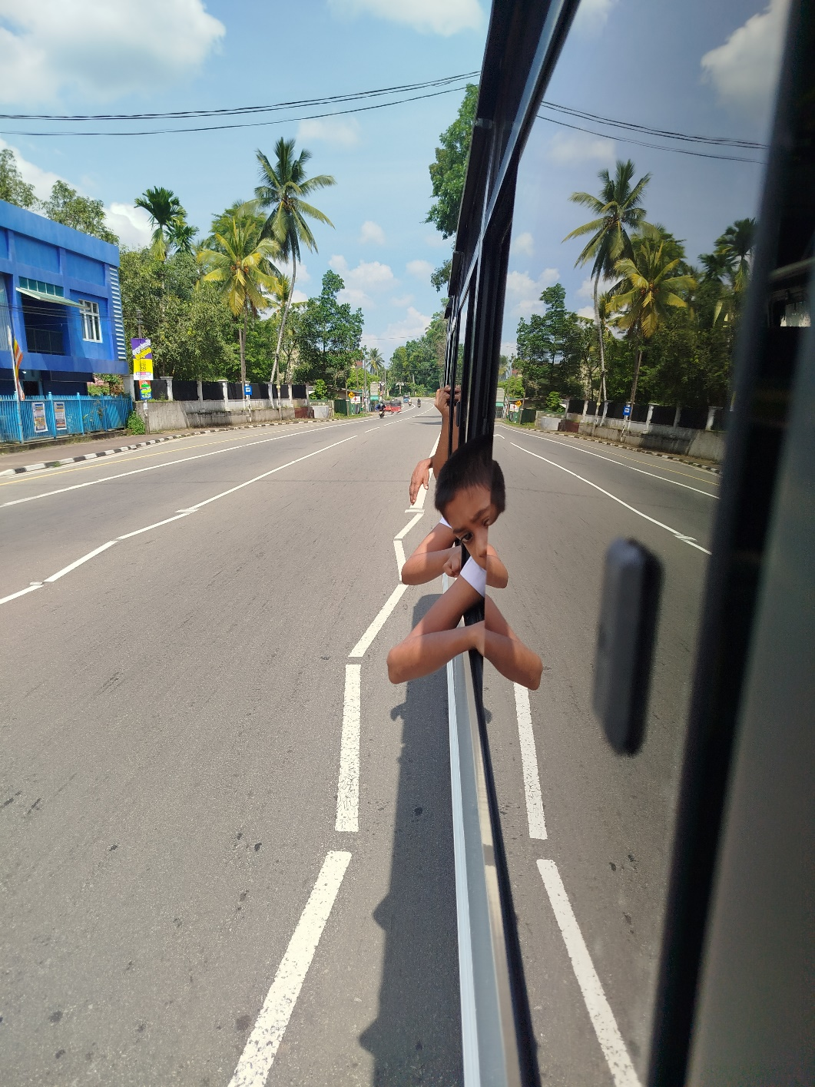
The Sensor & ML Approach
The system utilizes specialized sensors to detect sudden acceleration changes, smoke/fire, and water levels for comprehensive crash detection.
Machine Learning algorithms continuously monitor window areas to detect if students place their hands or heads outside the vehicle

Slide 19

IT22610102 | PINTO R.I.S.R Machine learning and iot based Foot board safety and driver monitoring
Specialized in Information Technology
IT22610102 | Pinto R.I.S.R | 25-26J-282

Slide 20
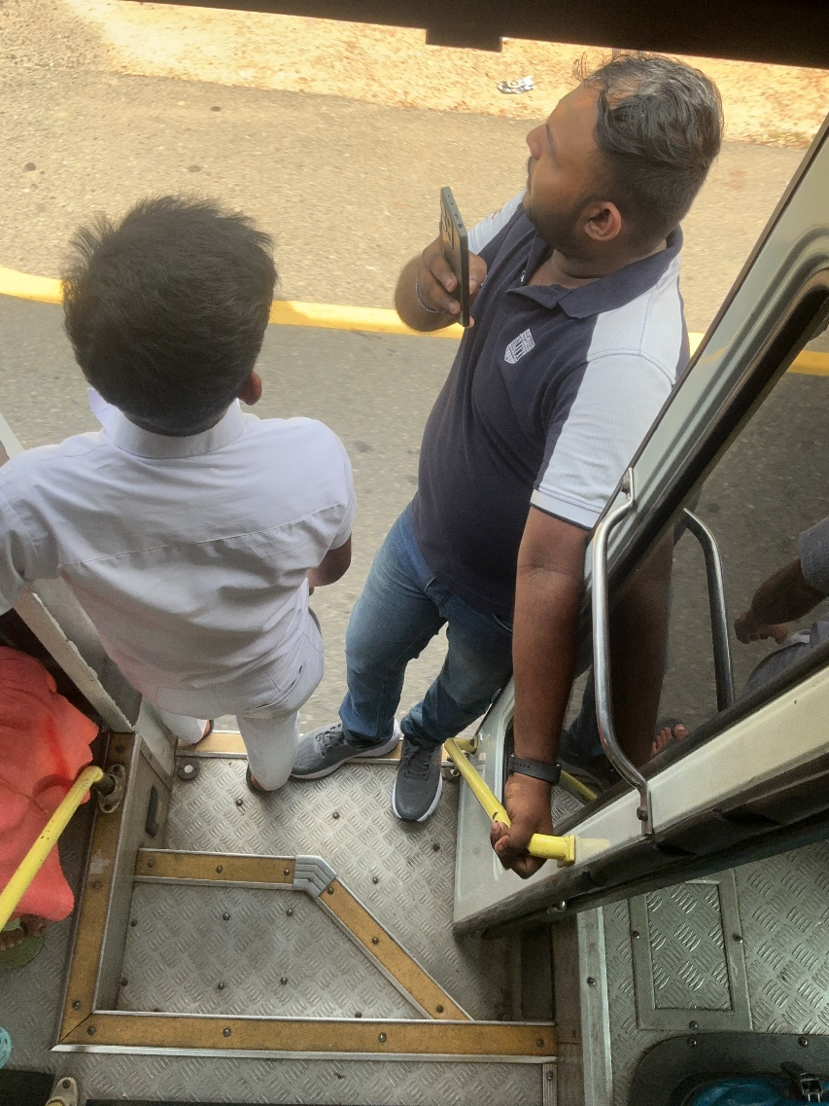
Machine learning and IOT based Foot board safety
A smart monitoring framework that uses IR sensors and computer vison for footboard safety and Computer Vision for driver state analysis
Core Purpose is : To prevent accidents caused by students traveling on bus steps and to ensure driver alertness through real-time fatigue and distraction detection.

Slide 21
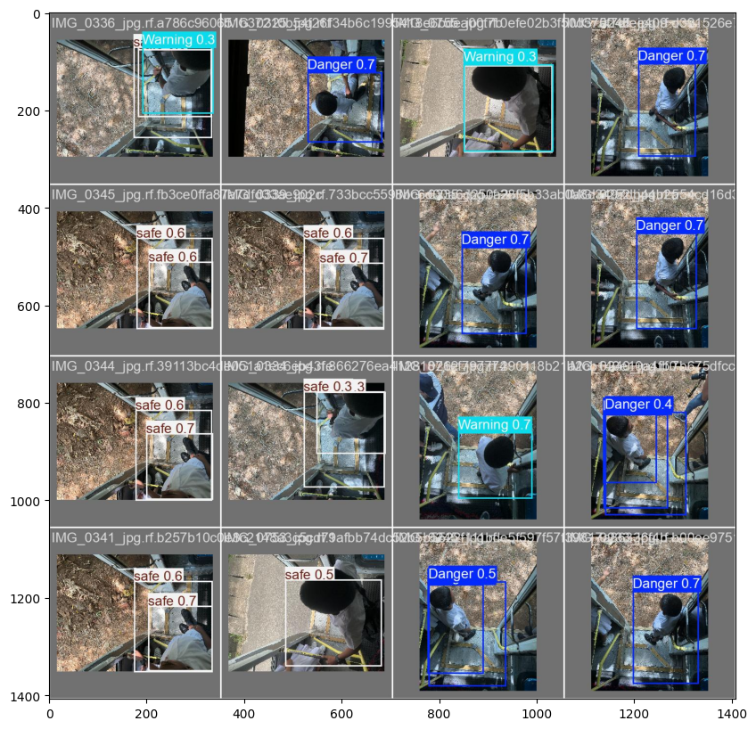
The Machine Learning & IoT Approach
The Machine Learning & IoT Approach
The system uses Infrared (IR) sensors to detect physical presence on the footboard while the bus is in motion.
Integrated Machine Learning algorithms monitor driver facial expressions to identify signs of drowsiness or distraction.

Slide 22
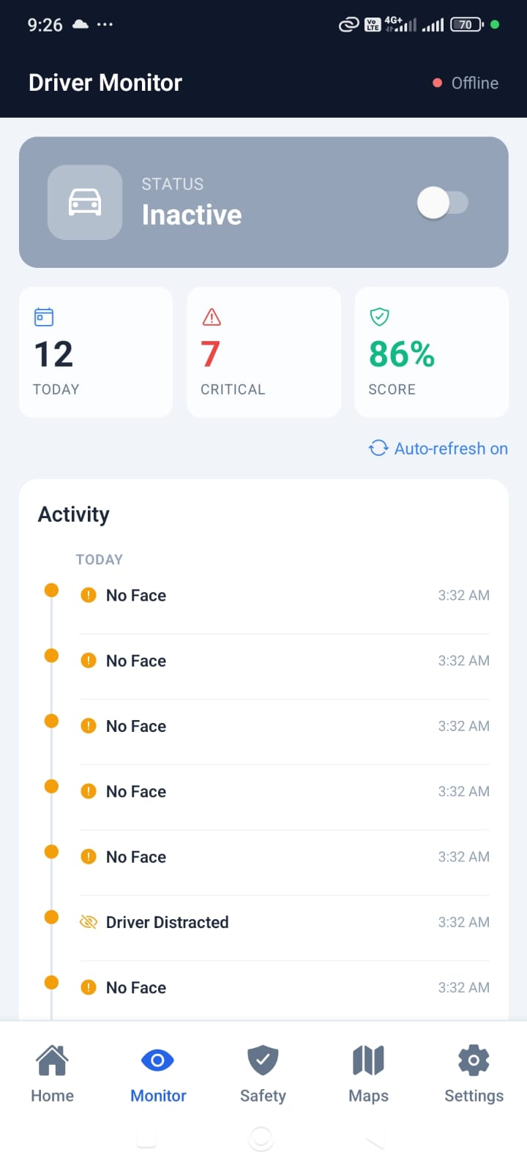
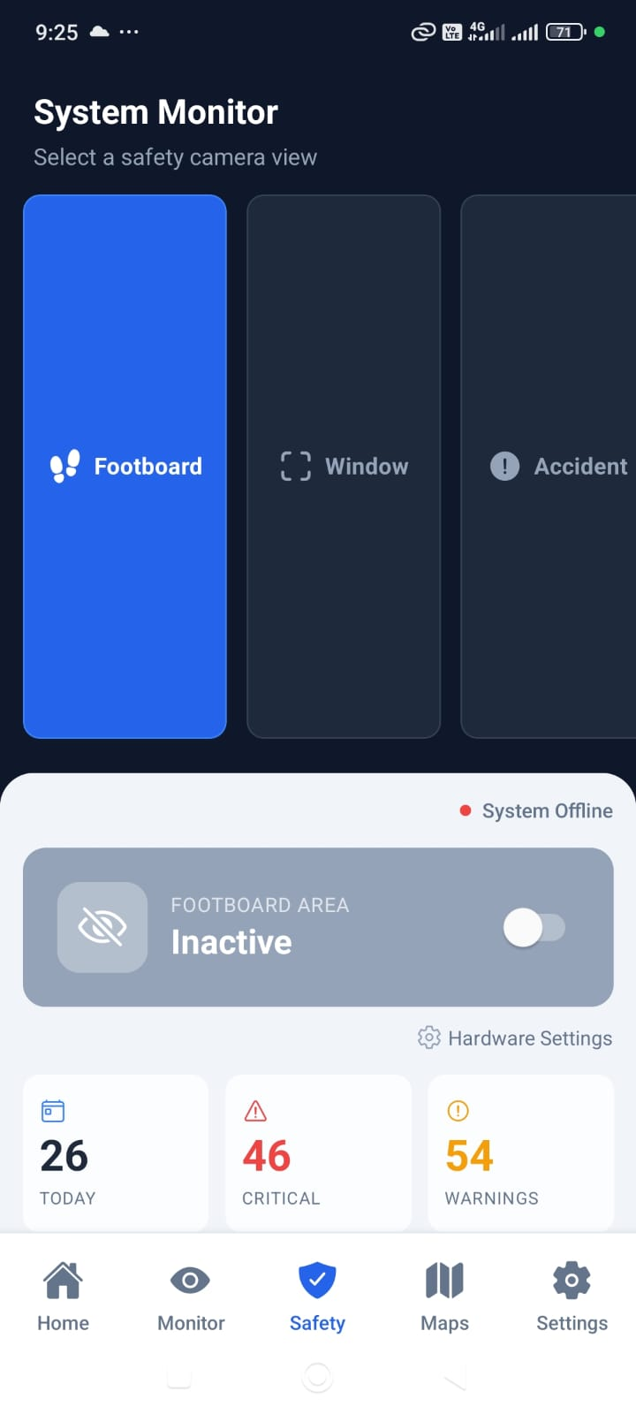
USER INTERFACES

Slide 23

IT22600134 | A.M.D.C.Kumara Smart Access and Emergency Management System with Facial Recognition and Centralized Control
Specialized in Information Technology
IT22600134 | A.M.D.C.Kumara | 25-26J-282

Slide 24
Smart Access and Emergency Management System with Facial Recognition and Centralized Control
An automated emergency exit door system that monitors bus speed and surroundings and automatically opens doors during accidents or when stationary to ensure safe passenger evacuation.
Enhances passenger safety by detecting accidents and unsafe conditions, checking vehicle speed and surroundings, and automatically opening emergency doors for quick evacuation.

Slide 25
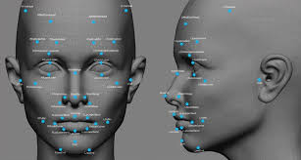
Smart Access and Emergency Management System with Facial Recognition and Centralized Control
A face recognition system that automatically tracks student attendance in real time without RFID cards, ensuring accurate monitoring and improved safety.
Core Purpose: To automatically identify students and mark attendance in real time using facial recognition, eliminating dependency on RFID cards and improving safety, accountability, and operational efficiency.

Slide 26
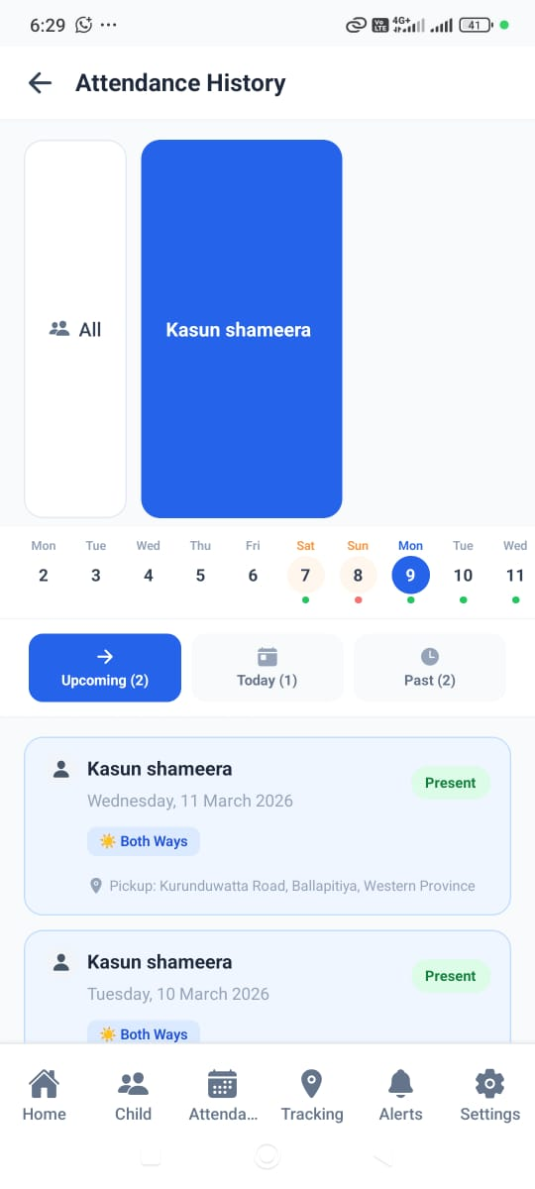
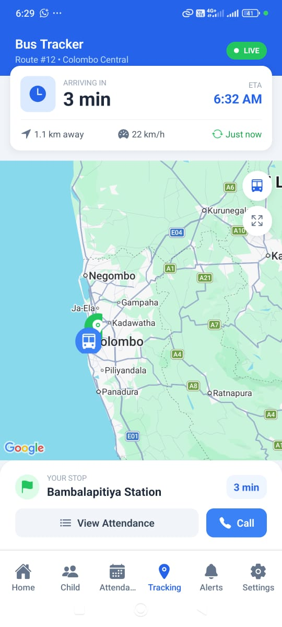
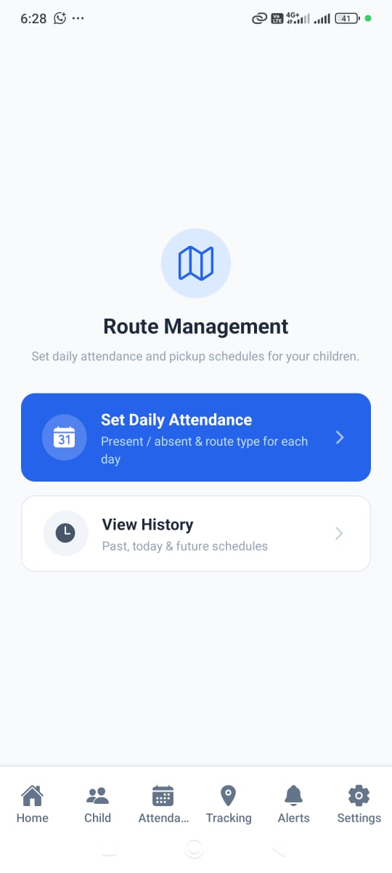
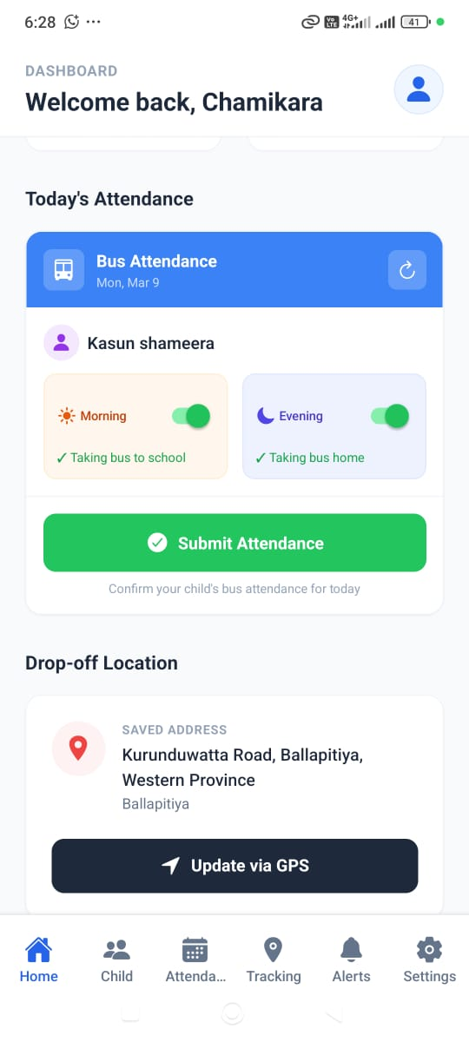
USER INTERFACES

Slide 27
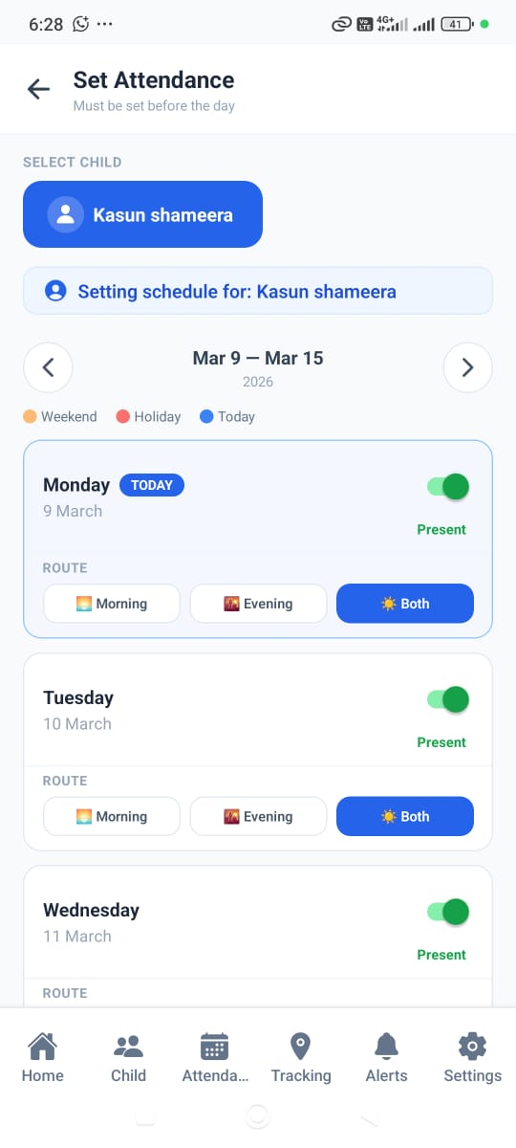
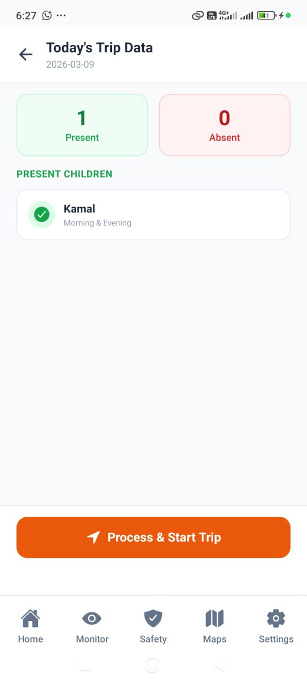
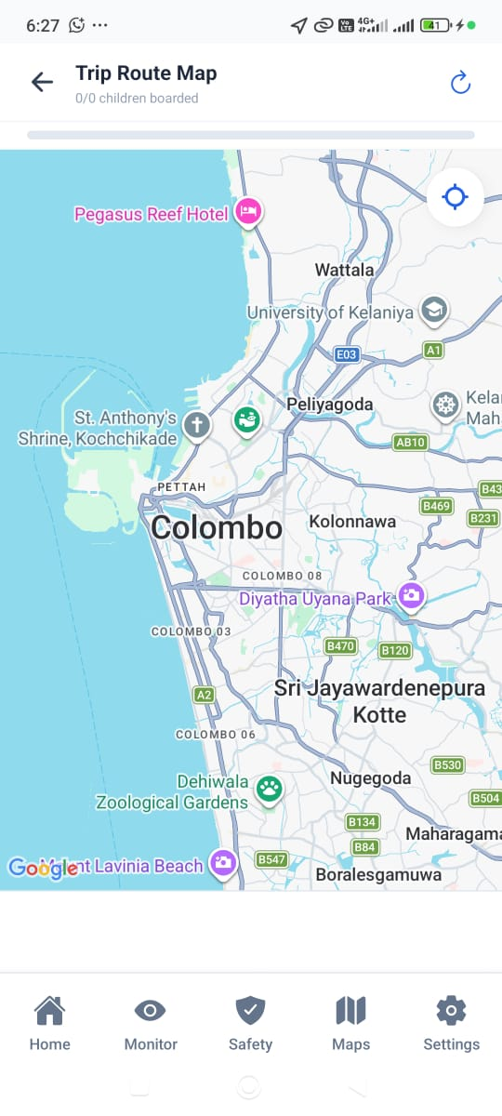
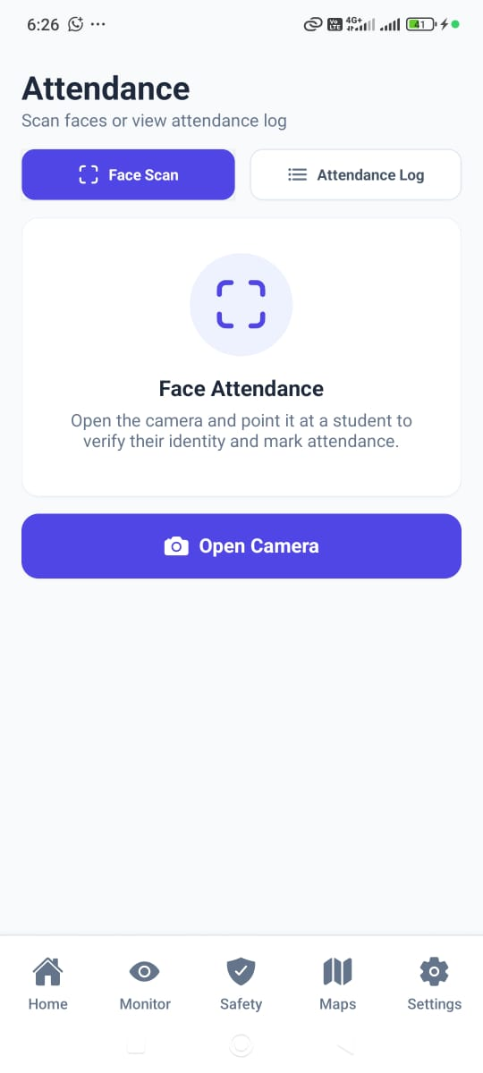
USER INTERFACES

Slide 28
The Machine Learning & IoT Approach
A system using face recognition and machine learning to track students, optimize dynamic bus routes, and ensure safe, efficient, and digitally monitored school bus operations.
An automated emergency door system using IoT sensors to detect unsafe conditions and accidents, enabling real-time, safe, and rapid evacuation on school buses.

