Slide 1


SISURAKSHA
Smart School Bus Safety and Monitoring Ecosystem
25-26J-282

Slide 2
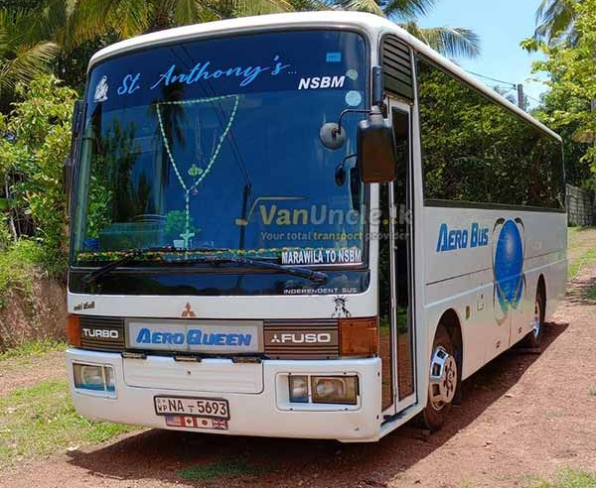
Introduction to the Problem
SISURAKSHA
Lack of Digital Attendance & Visibility
Dangerous behaviors such as students leaning out of windows and traveling on the footboard often go undetected due to the lack of continuous monitoring.
Drivers utilize static routing systems that fail to adapt to daily changes.
There is no unified mechanism for handling emergency situations

Slide 3
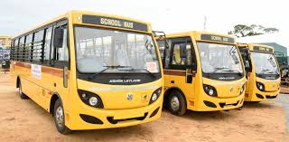
Research Gap
Current market solutions are isolated; they might offer GPS or CCTV, but they do not integrate them.
OUR SOLUTION
We are building a unified ecosystem that integrates NFC identity validation, ML-based driver verification, behavior recognition, and Blockchain-backed auditing for total transparency.
There is no existing end-to-end trust driven platform that combines attendance verification, safety monitoring, and emergency response in one system.

Slide 4
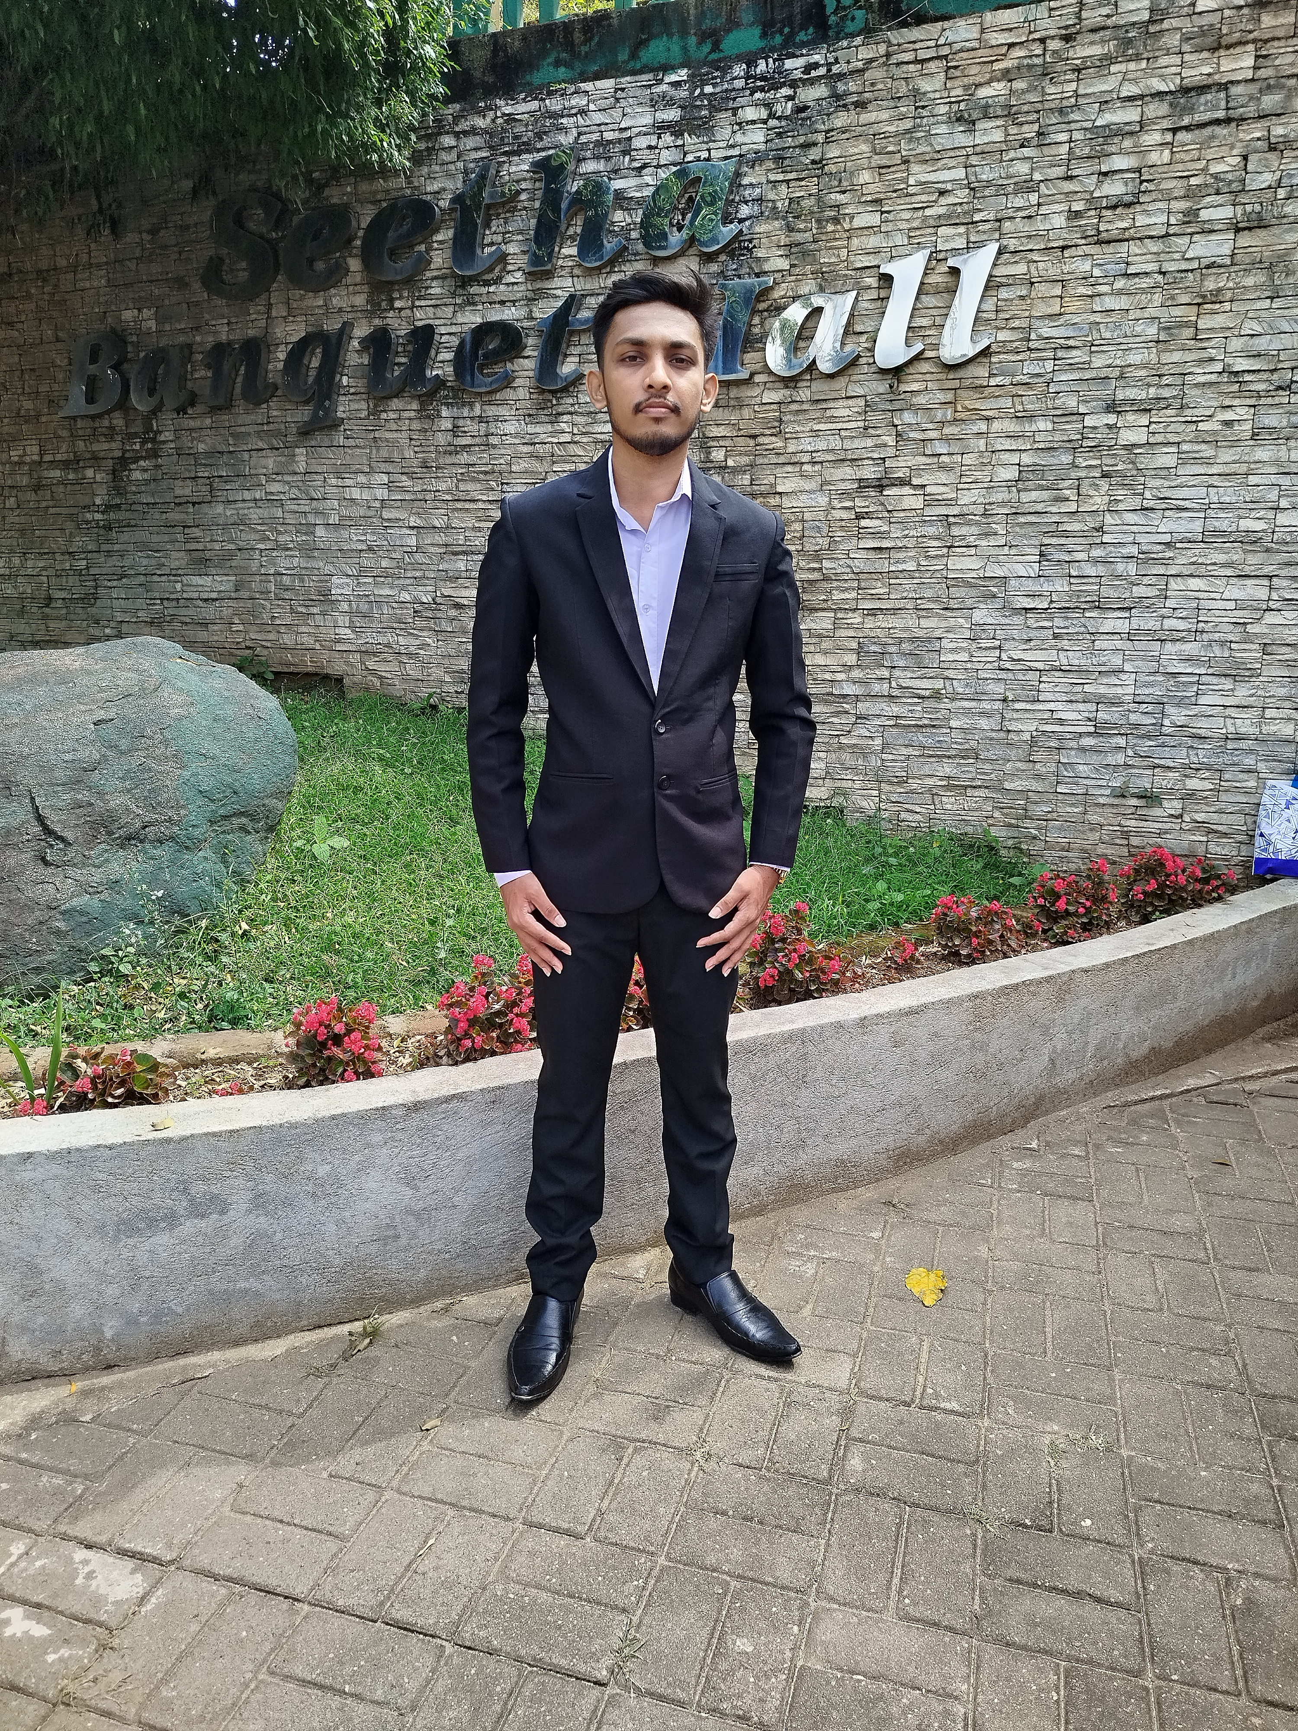
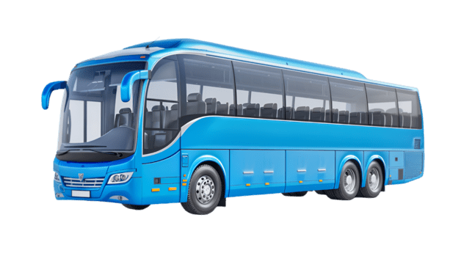
Blockchain Based RFID Attendance Management System and Segmented Polyline Analysis for Verifiable Driver-Student Matchmaking
IT22590312 | Akther M.H.S
Specialized in Information Technology
IT22590312 | Akther M.H.S | 25-26J-282

Slide 5
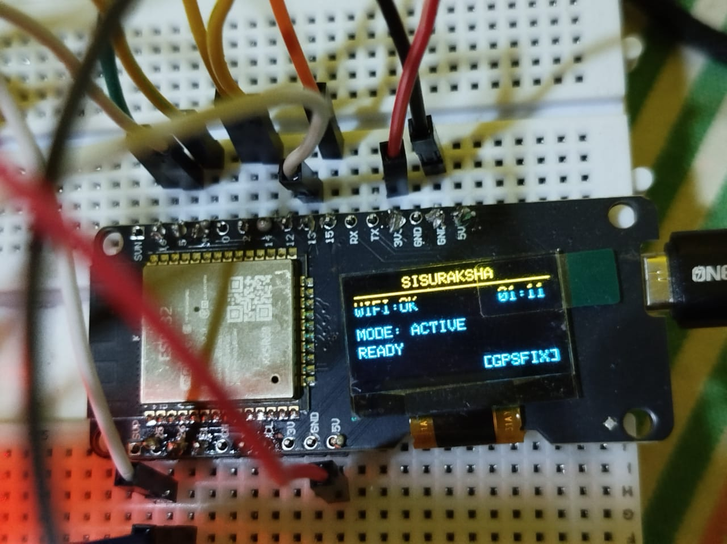
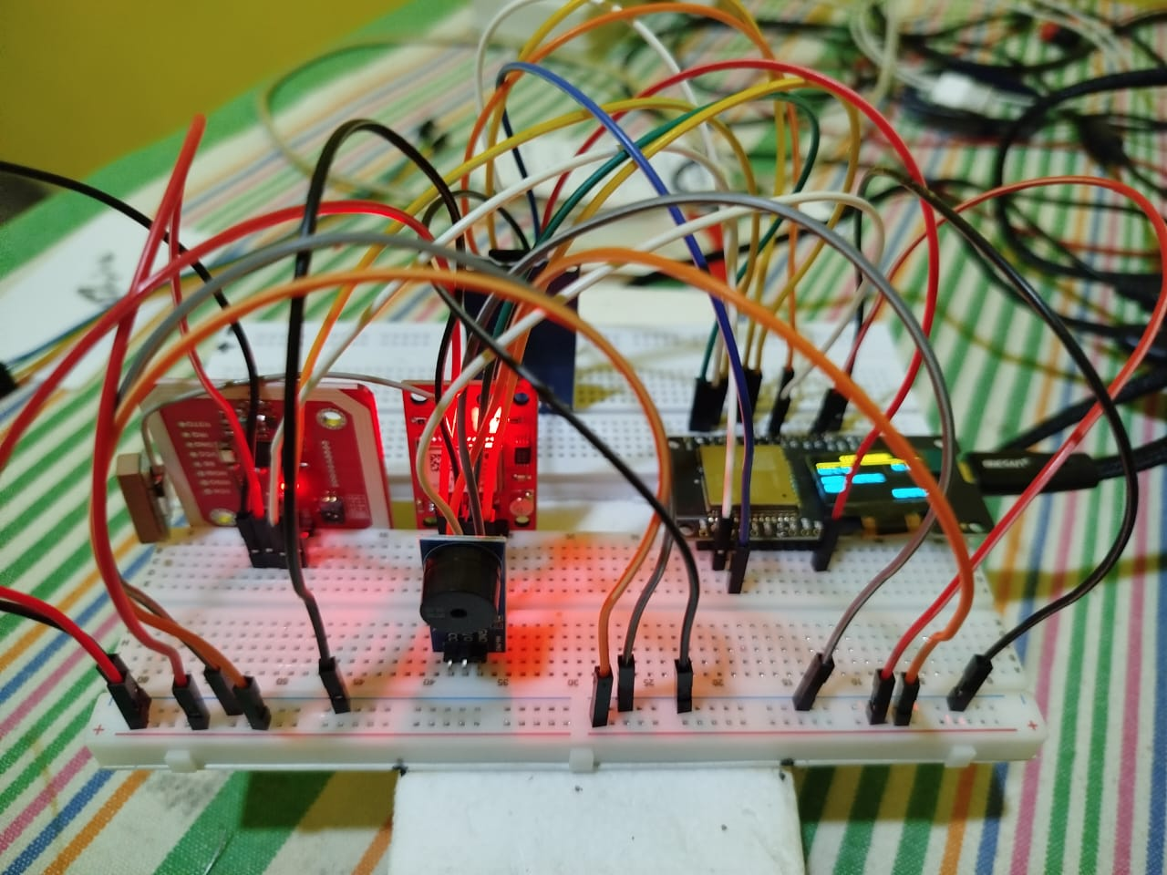
Blockchain Based RFID Attendance Management System
A secure IoT-integrated framework that uses RFID for automated student tracking and Blockchain for tamper-proof data storage.
Core Purpose is To bridge the gap between physical student movements and digital records with 100% data integrity.

Slide 6
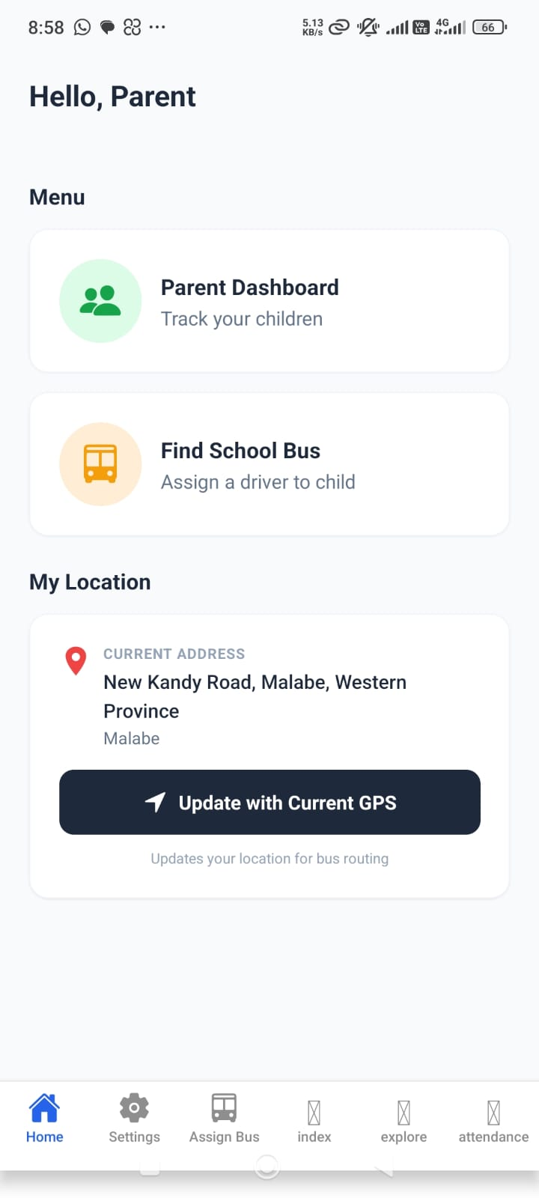
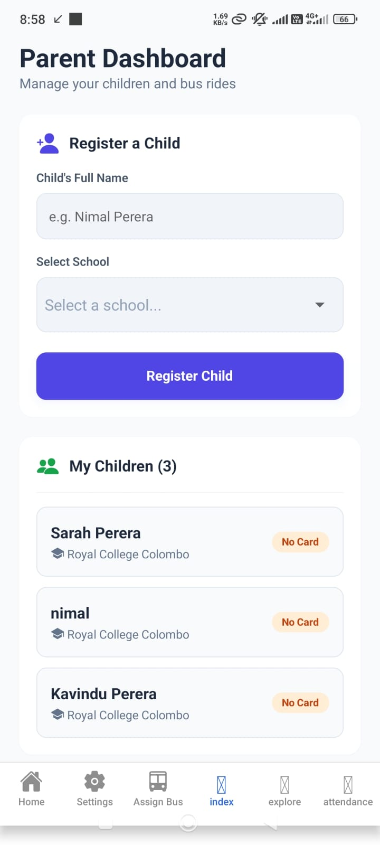
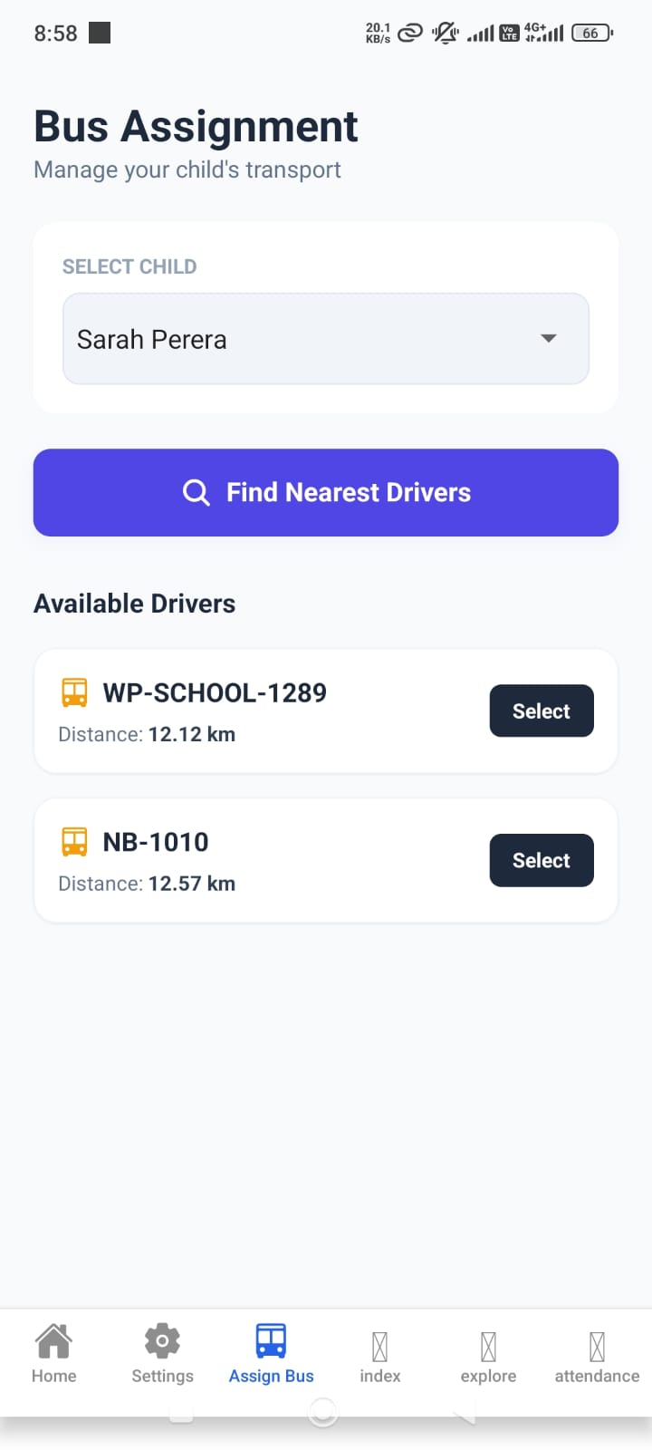
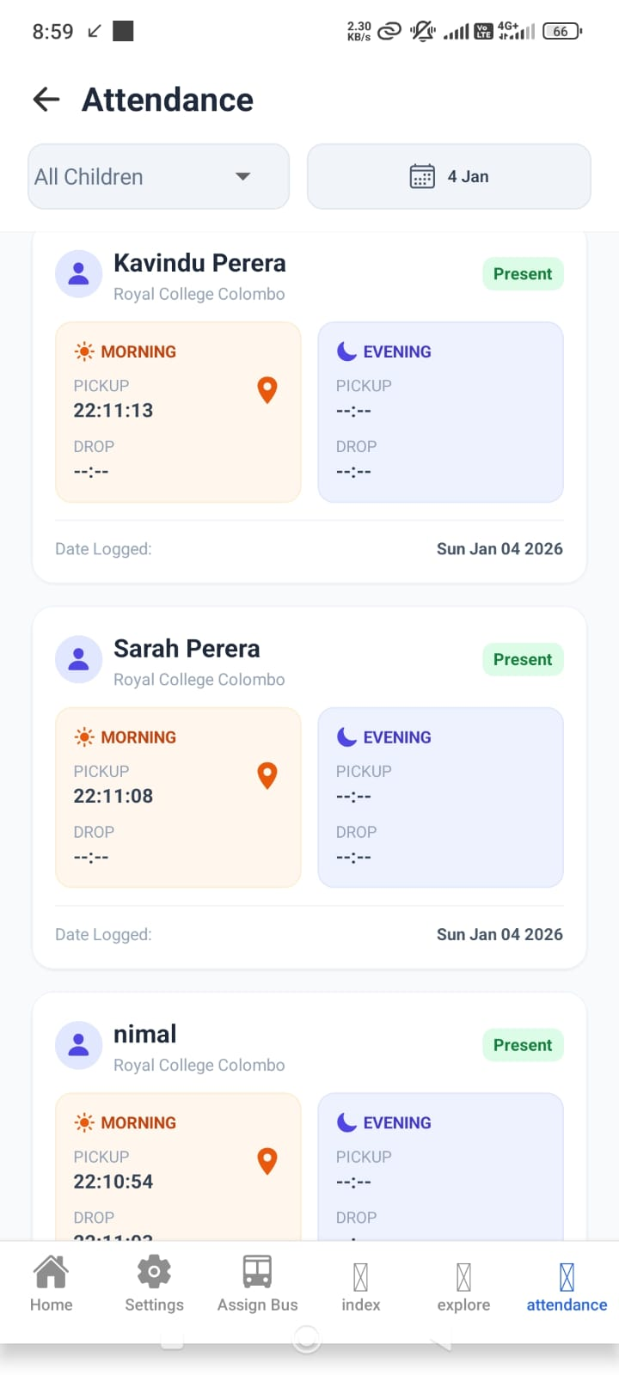
USER INTERFACES

Slide 7
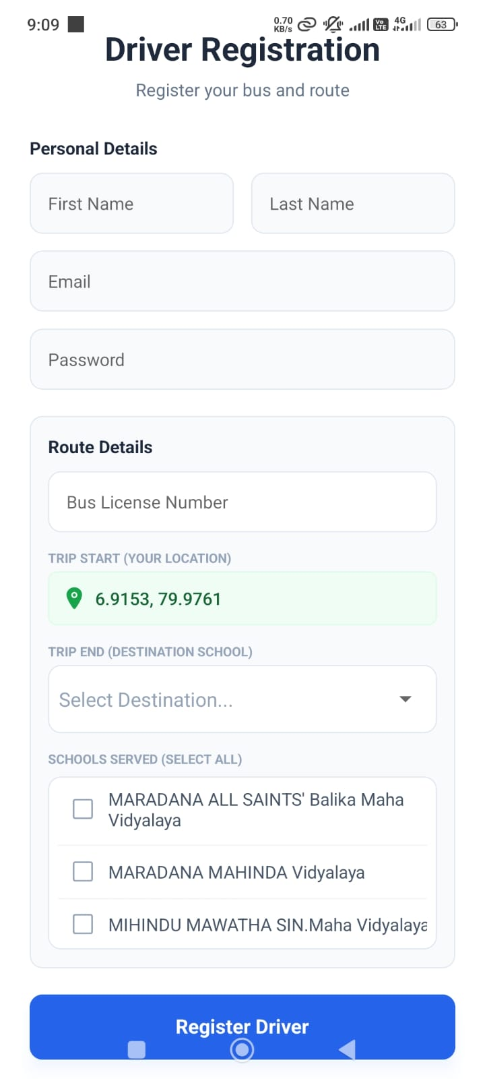
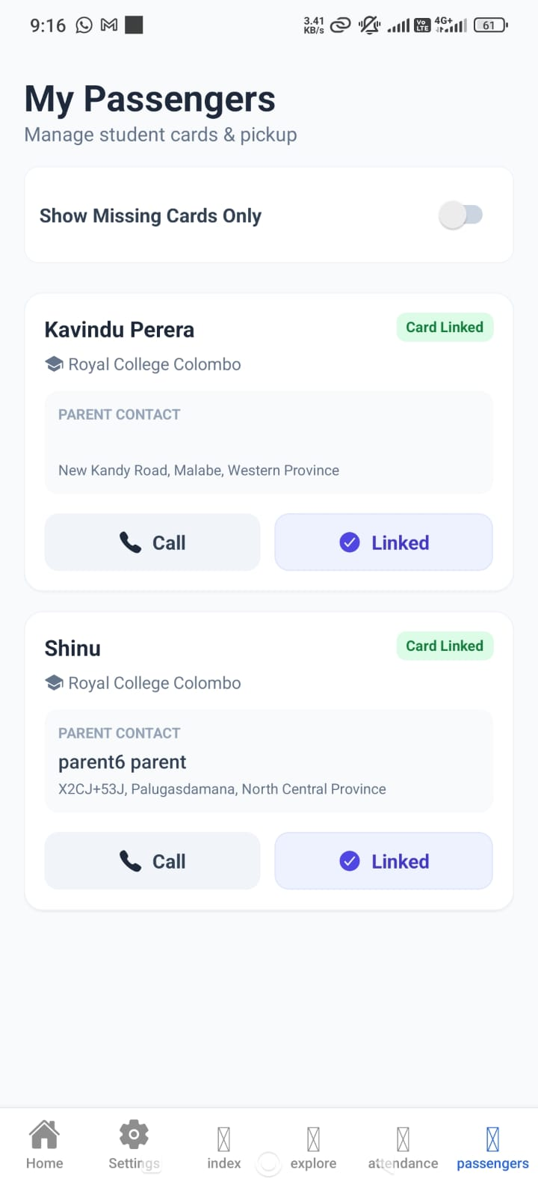
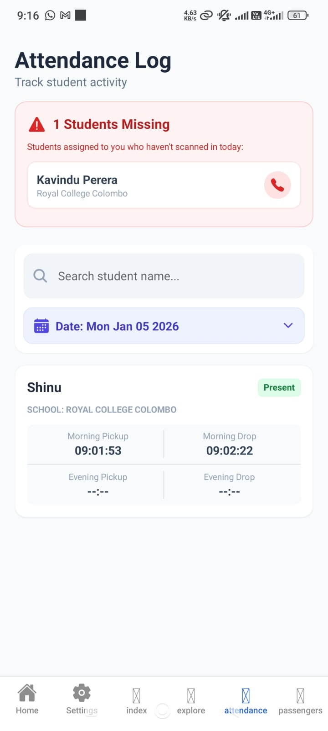
USER INTERFACES

Slide 8
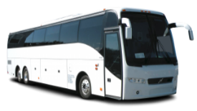
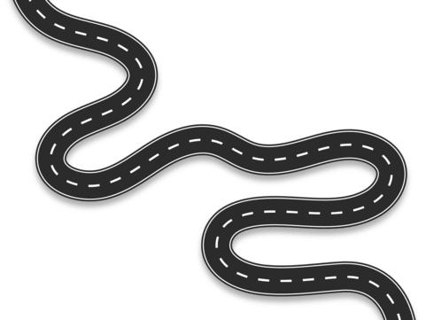
Segmented Polyline Analysis for Intelligent Driver-Student Matchmaking
Start
The Traditional Approach
Uses Euclidean distance (Straight lines) between two GPS points.
Problem is it Ignores physical urban geography (Buildings, Rivers, One-way streets).
Matches a bus physically close but operationally unreachable
User
End

Slide 9
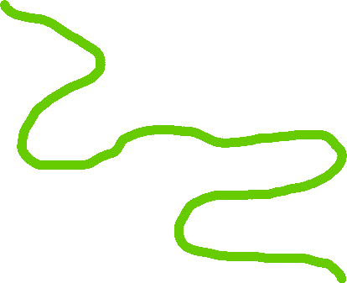
Segmented Polyline Analysis for Intelligent Driver-Student Matchmaking
Start
The polyline approach
The system detects drivers who actually drive past the student's home, even if their trip started far away.
Instead of drawing a straight line on a map, it checks the exact road path to see if the bus comes close enough to the house.
User
End

Slide 10

IT22606624 | Shameera T.A.P.K Smart bus crash detections and safety window
Specialized in Information Technology
IT22606624 | Shameera T.A.P.K | 25-26J-282

Slide 11
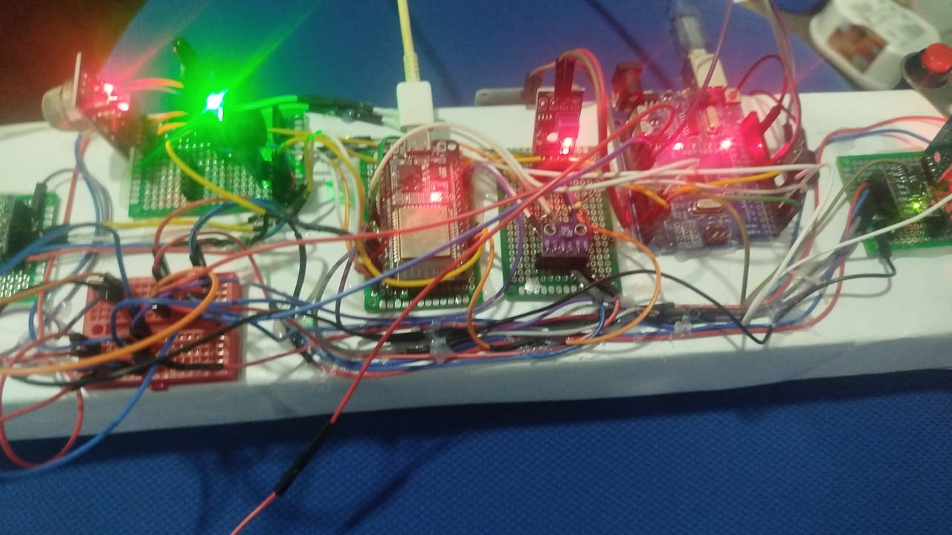
Problem & Core Purpose
A multi-sensor safety framework designed to detect vehicle crashes and monitor student window safety
Core Purpose: To provide immediate emergency response during accidents and prevent students from leaning out of windows using ML-based monitoring.

Slide 12
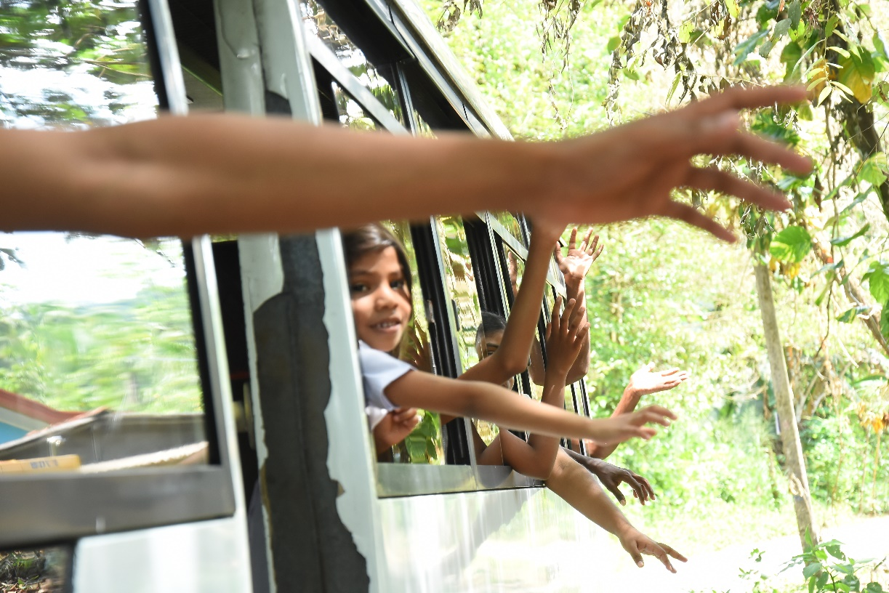
The Traditional Approach
The Traditional Approach
Uses standard vehicle safety features that do not provide real-time alerts for specific student behaviors.
Problem: There is no unified mechanism for handling emergency situations like fire, water submersion, or students leaning out.
Emergency response is often delayed due to a lack of automated impact and hazard detection

Slide 13
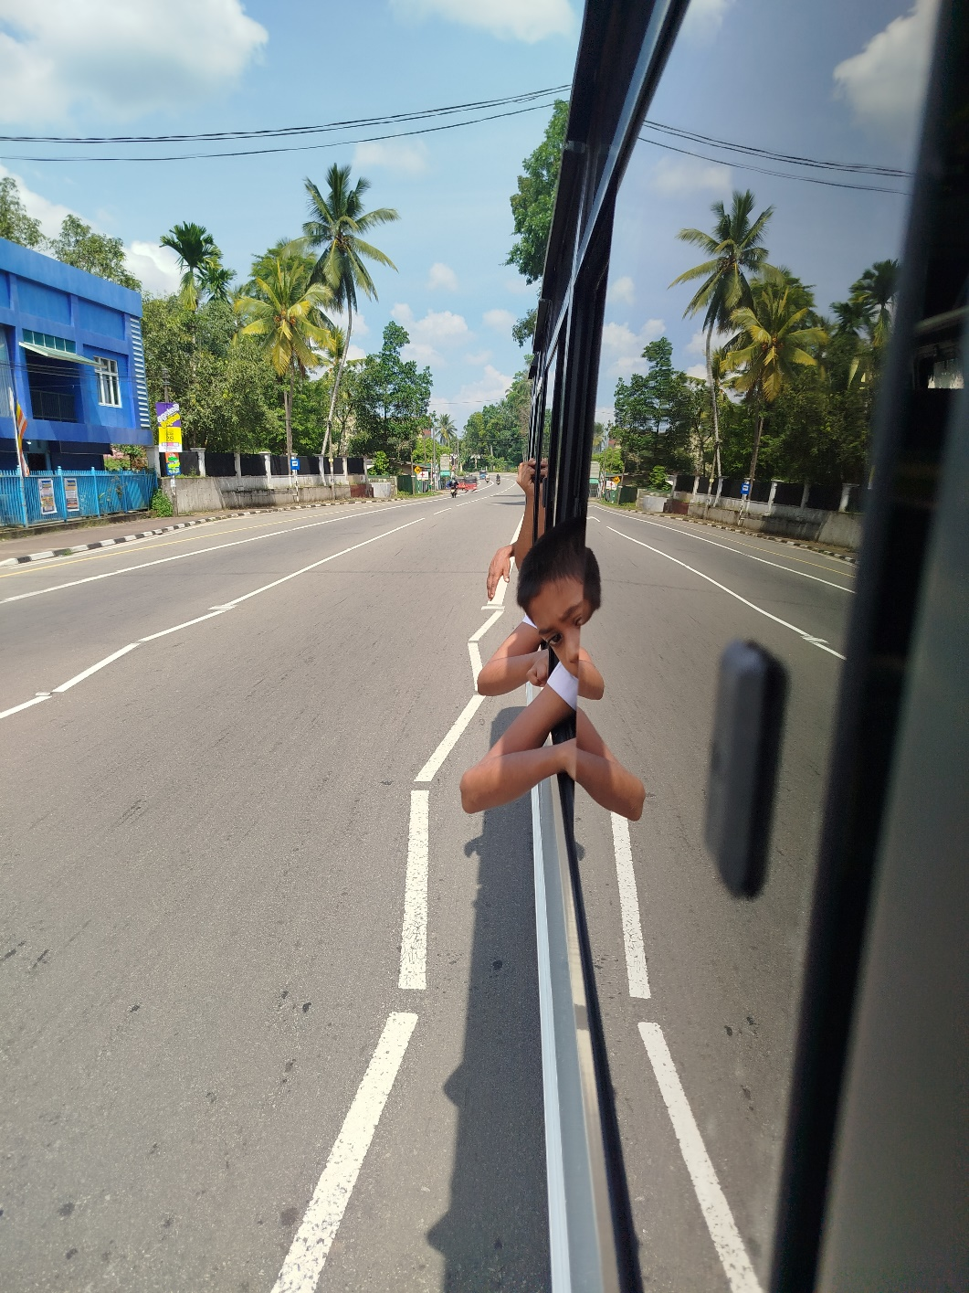
The Sensor & ML Approach
The Sensor & ML Approach
The system utilizes specialized sensors to detect sudden acceleration changes, smoke/fire, and water levels for comprehensive crash detection.
Machine Learning algorithms continuously monitor window areas to detect if students place their hands or heads outside the vehicle

Slide 14

IT22610102 | PINTO R.I.S.R Machine learning and iot based Foot board safety and driver monitoring
Specialized in Information Technology
IT22610102 | Pinto R.I.S.R | 25-26J-282

Slide 15
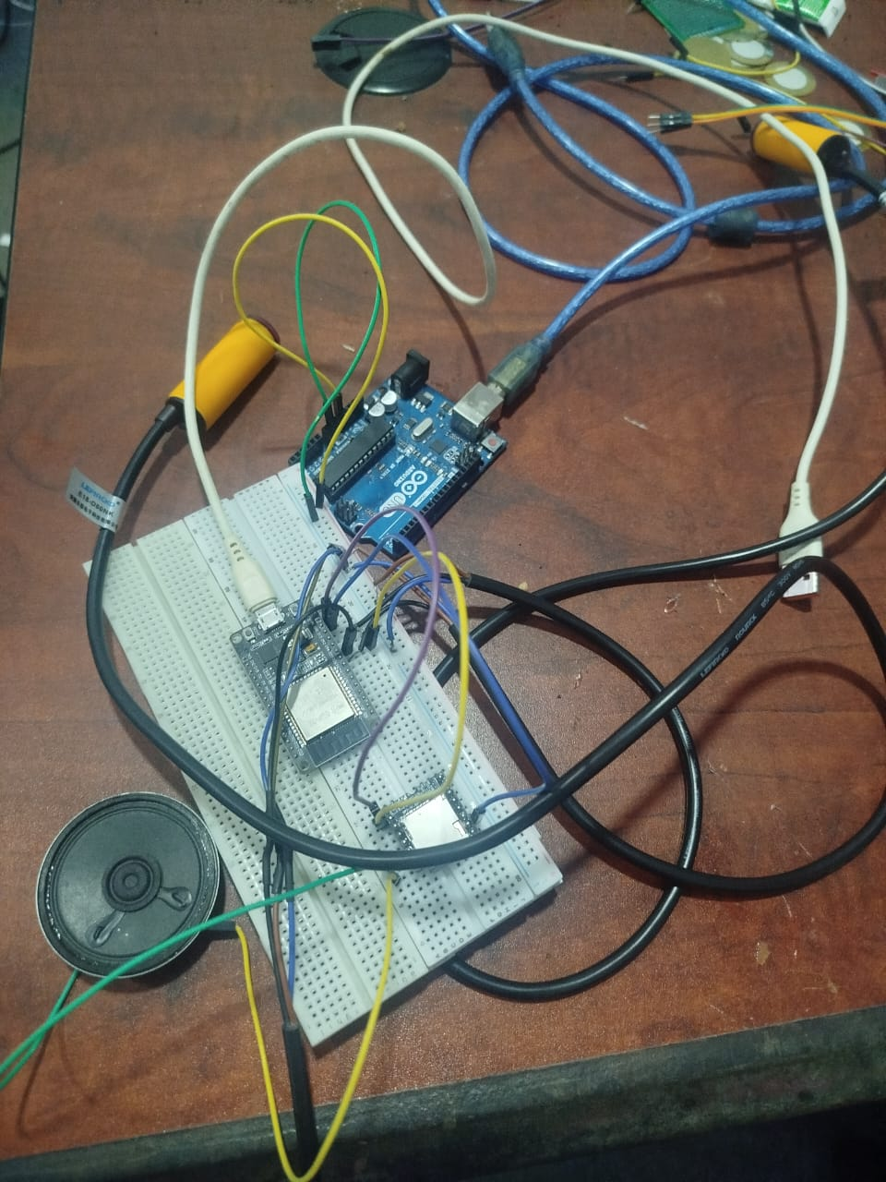
Problem & Core Purpose
A smart monitoring framework that uses IR sensors and computer vison for footboard safety and Computer Vision for driver state analysis
Core Purpose is : To prevent accidents caused by students traveling on bus steps and to ensure driver alertness through real-time fatigue and distraction detection.

Slide 16
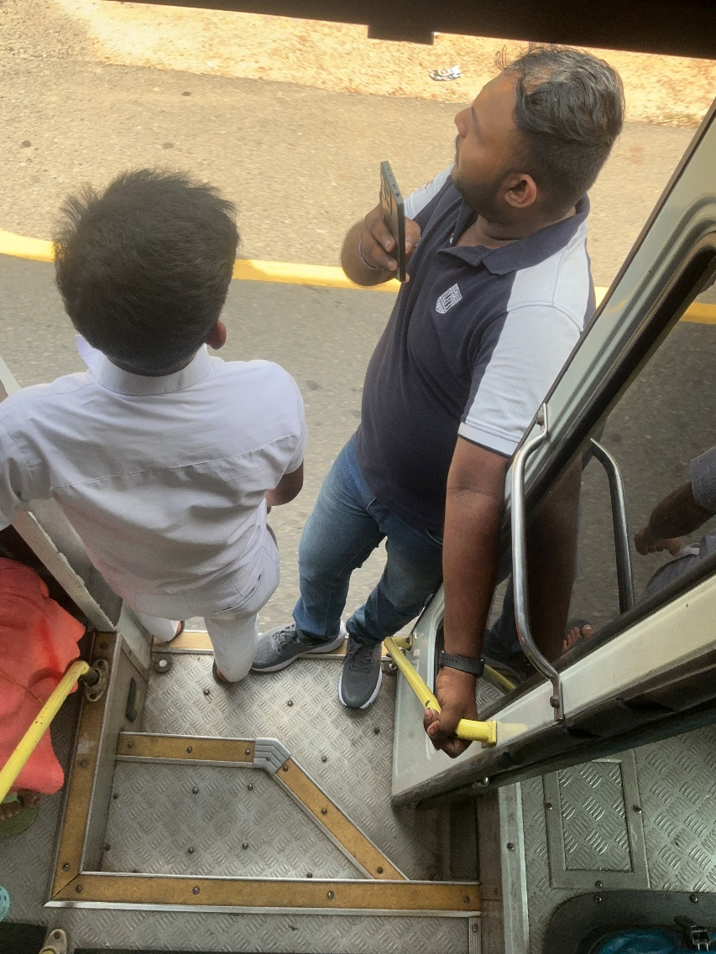
The Traditional Approach
The Traditional Approach
Relies on the driver's manual observation through mirrors to check the footboard.
Problem: Drivers are often distracted by traffic and cannot continuously monitor student behavior or their own fatigue levels
Results in undetected dangerous behaviors and increased risk of accidents.

Slide 17
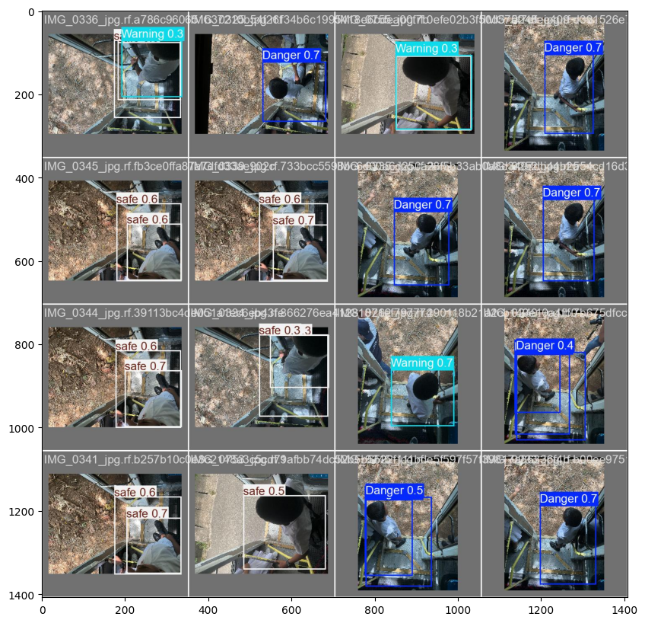
The Machine Learning & IoT Approach
The Machine Learning & IoT Approach
The system uses Infrared (IR) sensors to detect physical presence on the footboard while the bus is in motion.
Integrated Machine Learning algorithms monitor driver facial expressions to identify signs of drowsiness or distraction.

Slide 18

IT22600134 | A.M.D.C.Kumara Ai base smart navigation and face diction
Specialized in Information Technology
IT22600134 | A.M.D.C.Kumara | 25-26J-282

Slide 19

Problem & Core Purpose
An AI-driven navigation and attendance system that optimizes routes and uses facial recognition for identity verification.
Core Purpose is : To eliminate inefficient static routing and ensure 100% attendance accuracy even when physical RFID cards are forgotten.

Slide 20
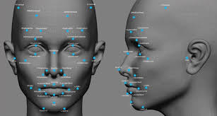
The Traditional Approach
The Traditional Approach
Drivers utilize static routing systems that fail to adapt to daily changes in student attendance.
Problem: Buses waste time and fuel traveling to stops where no students are present for that specific day.
Attendance relies solely on physical RFID cards, leading to manual errors if a card is lost or forgotten.

Slide 21
The Machine Learning & IoT Approach
The Machine Learning & IoT Approach
Machine Learning models analyze the daily attendance sheet to calculate the optimal path, bypassing unnecessary stops.
The system features a Face Recognition algorithm that identifies students as they board, serving as a fail-safe for RFID systems.
Instead of fixed routes, the bus follows a dynamic path, while the AI ensures every student's movement is digitally recorded.

